Slide 1











REAL TIME IMAGE CLASSIFICATION AND
OBJECT DETECTION USING TENSORFLOW LITE
ON RASPBERRY PI 4B

Slide 2






REAL TIME IMAGE CLASSIFICATION AND OBJECT DETECTION USING TENSORFLOW LITE ON RASPBERRY PI 4B
Project Supervisor
Dr. ANKIT KUMAR JAISWAL
sCHOOL OF ENGINEERING
jAWAHARLAL NEHRU uNIVERSITY

Slide 3

GROUP MEMBERS
Neeraj Nikhil Roy 20/11/EC/053
(Group Coordinator)
Kshama Meena 20/11/EC/055
Komal Kesav Nenavath 20/11/EC/012
Divyansh Singh 20/11/EC/057

Slide 4

CONTENTS
Introduction
Literarture
Edge Tech
Methodology
Results
Fututre scope
What we are using
what we are trying to achieve
What is our final form?
History of the Surveillance system and the problems faced by current technology
Details about the cutting edge technologies used in order to achieve the goal
How do we achieve this goal by applying the we have discussed
What are the outcomes of our work and how it compares with other
Conclusions that we draw and future developments and improvements in the project.

Slide 5
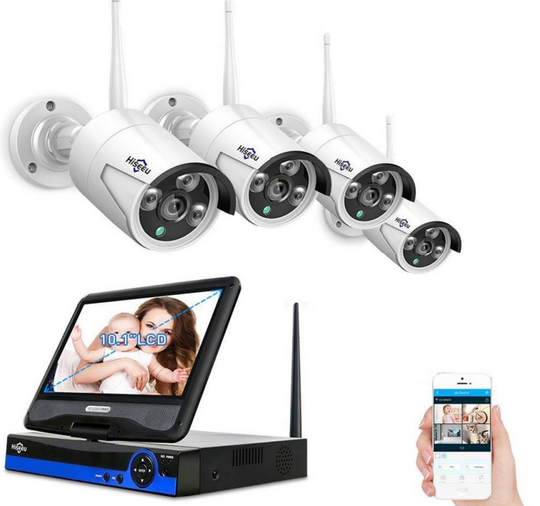
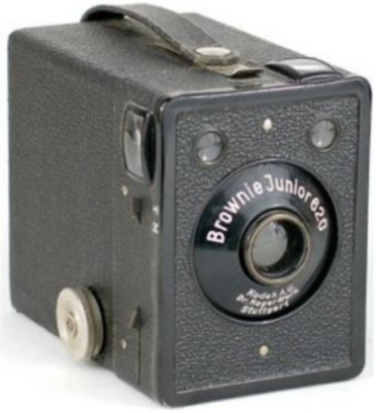
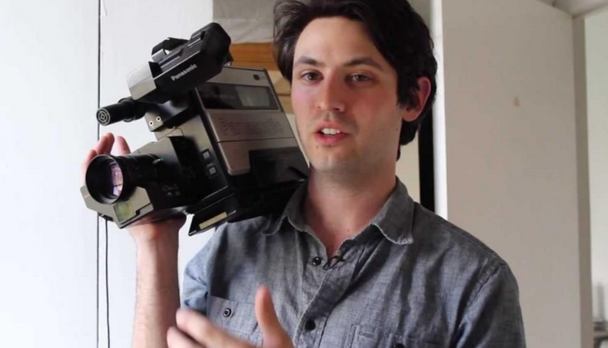
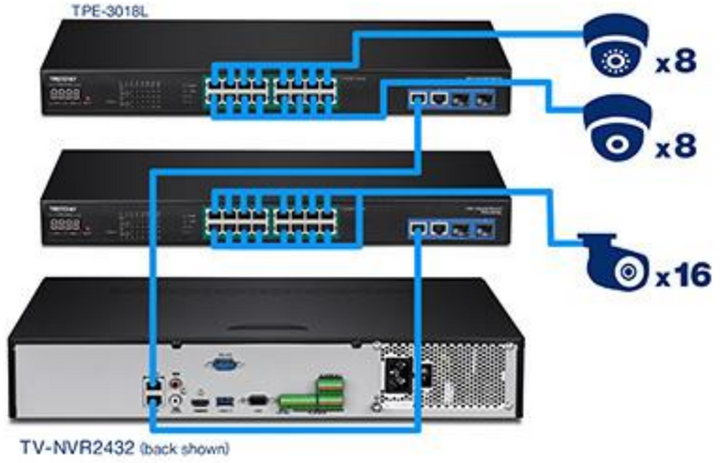
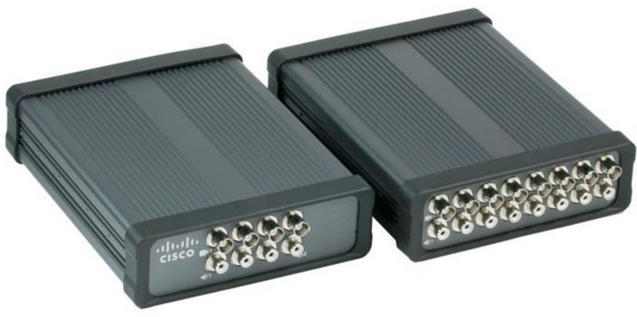
HISTORY AND EVOLUTION
Analog cctv system
Digital IP CCTV Cameras
VCR’s(videocassette recorders)
Video Encoders
Network based dvr
Notes:
Yet not completely functional In early day we got the analog cameras and in 1942 the first documented cctv,
Since it wasn't able to record and store data, it required constant monitoring and was used just as a prototype rather than a complete functioning model
these were widely implemented in the 1970s. Images were stored in tapes that lasted for about 8 hours of recording and had to be manually replaced.
Later on, DVRs were equipped with an Ethernet port for network connectivity. This allowed for remote video monitoring using a computer.
thought to be the next big step in the technology. The most important innovation is that with this system the video management is operated through the software installed in a computer.
This system is fully digital and doesn't include any analog component. That has significantly simplified the installation and maintenance of the system. It has computer power built in, allowing for the use of preinstalled applications in the camera, and they can synchronize with other devices.

Slide 6
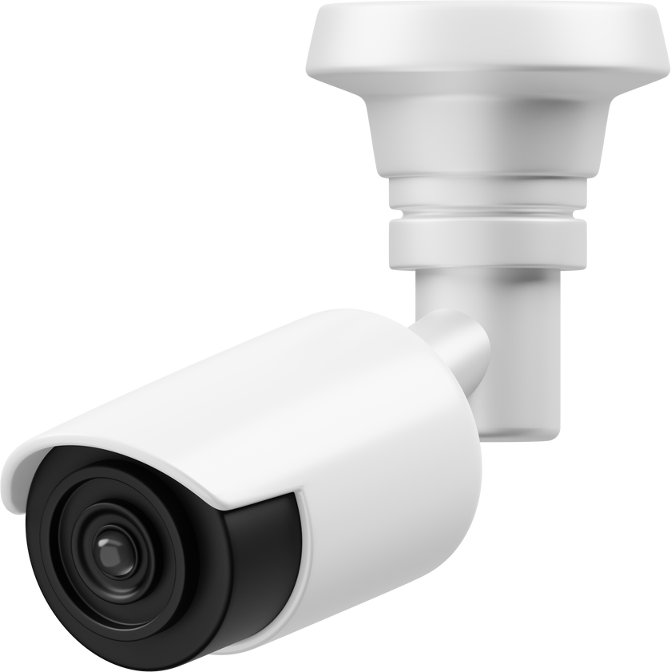

FLAWS IN TODAYS TECH !
ALMOST ALL CAMERAS TODAY ARE USED TO RECORD FOOTAGE THAT HAS TO BE LATER ANALYZED BY HUMANS IF SOMETHING HAPPENS. NOT ONLY IS THIS PROCESS VERY SLOW, BUT IT'S COSTLY AND REQUIRES HUMAN ATTENTION.
SECURITY VULNERABILITIES.
DATA STORAGE AND MANAGEMENT CHALLENGES.
UNECESSARY LABOUR.
Notes:
Almost all cameras today are used to record footage that has to be later analyzed by humans if something happens. Not only is this process very slow, but it's costly and requires human attention.
Security vulnerabilities: Cameras and their associated systems can be vulnerable to security breaches, allowing unauthorized access to footage or control of the camera.
Data storage and management challenges: The vast amount of data generated by cameras can be challenging to store, manage, and analyze efficiently.

Slide 7

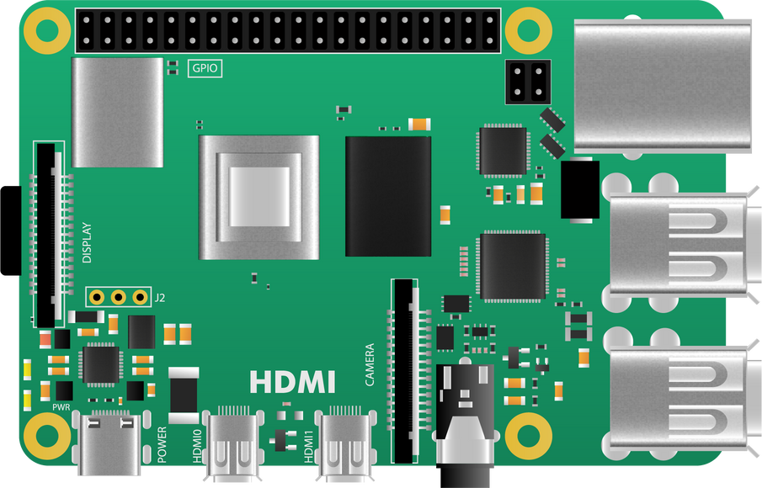
HOW TO SOLVE THIS PROBLEM?
WE CAN ACHIEVE OUR OBJECTIVE BY:-
REAL-TIME IMAGE CLASSIFICATION:
OBJECT DETECTION MODULE:
RASPBERRY PI 4B DEPLOYMENT:
ACCURATELY CLASSIFYING IMAGES IN REAL-TIME.
TENSORFLOW LITE
DEVELOPING OBJECT DETECTION.
IDENTIFY AND TRACK MULTIPLE OBJECTS CONCURRENTLY.
DEPLOYING THE ENTIRE SYSTEM ON THE RASPBERRY PI 4B.
ADVANTAGES OF EDGE COMPUTING FOR ON-DEVICE PROCESSING.
Notes:
1.Implementing a system capable of accurately classifying images in real-time using TensorFlow Lite.
2.To identify

Slide 8

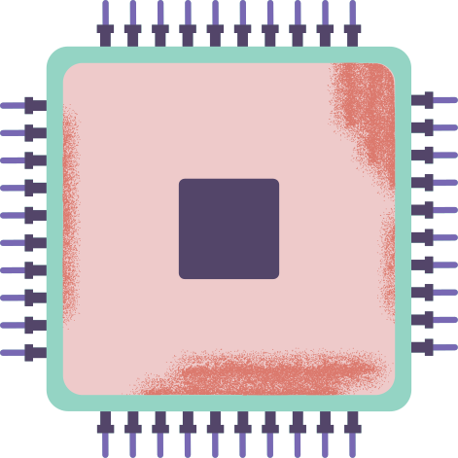
WHY REAL-TIME COMPUTATION ?
SCALABILITY, RESOURCE CONSUMPTION AND ADAPTABILITY.
ANOMALY DETECTION
LOW LATENCY
TECHNOLOGY EQUIPPED WITH MACHINE LEARNING TOOLS HELP MAKE OBJECT DETECTION EASY.
Notes:
Conventional methods often face scalability, resource consumption, and adaptability challenges. Considering recent developments in machine learning, we could achieve real-time detection and notify the user/owner or detect an anomaly, using this cutting edge technology equipped with machine learning tools help make object detection easy.

Slide 9


WHAT IS OBJECT DETECTION ?
ABILITY TO IDENTIFY AN OBJECT BASED ON IMAGE CLASSIFICATION, IMAGE SEGEMENTATIONS.
OBJECT DETECTION MODULE IS DESIGNED TO IDENTIFY AND TRACK MULTIPLE OBJECTS CONCURRENTLY WITHIN THE SURVEILLANCE ENVIRONMENT.
BY USING THE HELP OF THE TRAINED DATA THE MODEL COMBINED WITH RASPBERRY PI IT CAN GIVE REAL-TIME UPDATES ON DETECTED OBJECTS.
Notes:
The ability to identify an object based on Image classification, image segmentations. The object detection module is designed to identify and track multiple objects concurrently within the surveillance environment.by using the help of the trained data the model combined with raspberry pi it can give real-time updates on detected objects.

Slide 10

Raspberry Pi
ITS A SINGLE BOARD COMPUTER

Slide 11
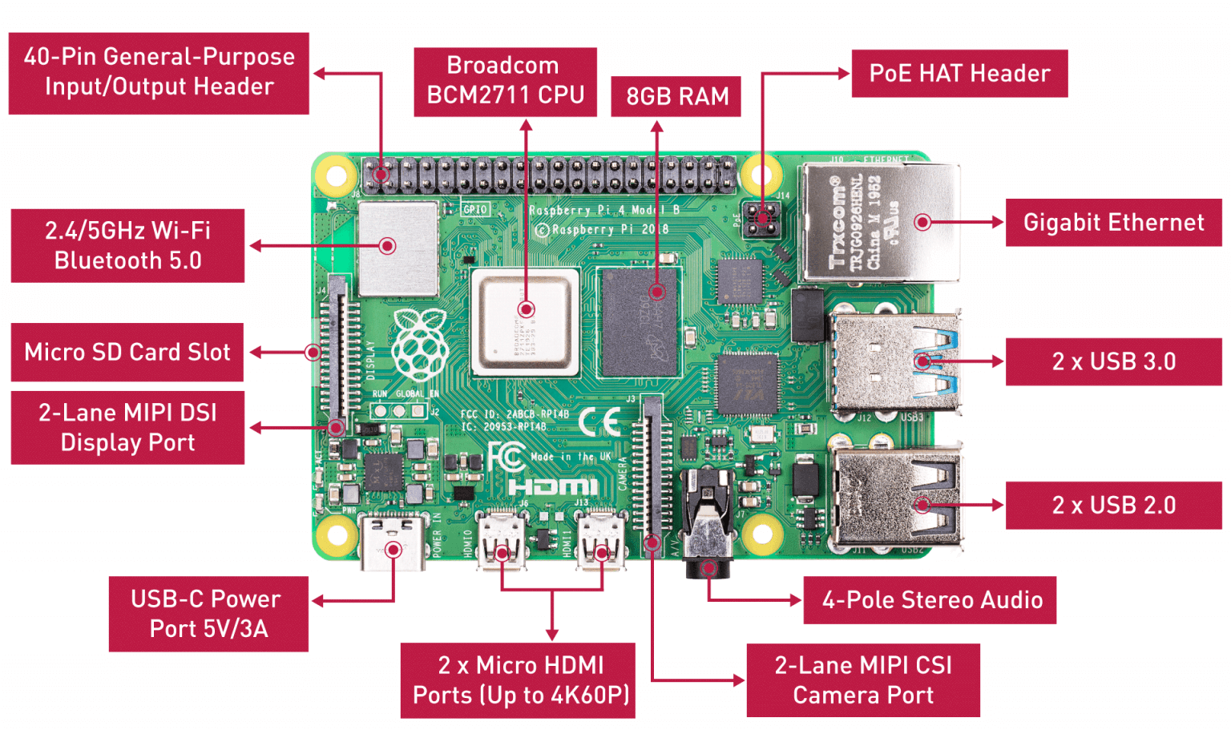

Slide 12
ABOUT THE PI 4(SOFTWARE)
The Raspberry Pi 4 Model B is a versatile single-board computer (SBC) that can run a variety of operating systems. The most popular operating system for the Raspberry Pi 4 is Raspberry Pi OS, a Debian-based Linux distribution specifically tailored for the Raspberry Pi. It is a user-friendly operating system with a graphical user interface (GUI) and a wide range of pre-installed software. Raspberry Pi OS is also regularly updated with new features and security patches.
Notes:
The Raspberry Pi 4 Model B is a versatile single-board computer (SBC) that can run a variety of operating systems. The most popular operating system for the Raspberry Pi 4 is Raspberry Pi OS, a Debian-based Linux distribution specifically tailored for the Raspberry Pi. It is a user-friendly operating system with a graphical user interface (GUI) and a wide range of pre-installed software. Raspberry Pi OS is also regularly updated with new features and security patches.

Slide 13
ABOUT THE PI 4(HARDWARE)
SPECIFICATIONS OF THE PI
•Processor: Broadcom BCM2711, Quad core Cortex-A72 (ARM v8) 64-bit SoC @ 1.8GHz
• RAM: 1GB, 2GB, 4GB, or 8GB LPDDR4-3200 SDRAM (depending on model) • GPU: VideoCore VI with support for OpenGL ES 3.1 and Vulkan 1.1
• Storage: microSD card slot for up to 2TB
• Connectivity: Gigabit Ethernet, dual-band Wi-Fi 5 (802.11ac), Bluetooth 5.0
• Ports: 2x micro HDMI (up to 4K resolution at 30fps), 2x USB 3.0, 2x USB 2.0, 40-pin GPIO header, 3.5mm audio jack

Slide 14
HOW’S THE PI 4 IS HELPFUL
Hardware Platform
TensorFlow Lite Support
Real-time Object Detection
Anomaly Detection
Reduced Human Intervention
Cost-Effective Solution
Notes:
Hardware Platform: The Raspberry Pi 4 provides a compact and powerful processing platform for running machine learning algorithms. Its quad-core ARM Cortex-A72 processor and 4GB of RAM can handle the computational demands of object detection and anomaly analysis.
TensorFlow Lite Support: TensorFlow Lite is a lightweight machine learning framework optimized for mobile and embedded devices like the Raspberry Pi 4. It enables you to efficiently run pre-trained object detection models on the Raspberry Pi, leveraging its hardware capabilities.
Real-time Object Detection: The Raspberry Pi 4, equipped with TensorFlow Lite, can perform real-time object detection, identifying and tracking objects within the video feed. This real-time capability is essential for continuous surveillance and anomaly detection.
Anomaly Detection: The Raspberry Pi can identify patterns that deviate from normal behavior by analyzing the detected objects and their movements. This anomaly detection feature allows for flagging potentially suspicious activities or events.
Reduced Human Intervention: The Raspberry Pi's ability to detect objects, track their movements, and identify anomalies significantly reduces the need for human intervention in surveillance. It can autonomously monitor the scene and alert human operators only when necessary.
Cost-Effective Solution: The Raspberry Pi 4 offers a cost-effective solution for implementing a surveillance system with object detection and anomaly detection capabilities. Its affordability makes it accessible to a wider range of applications and settings.

Slide 15
BEFORE WE DIVE IN
Let's discuss cutting-edge tools that can give a great explanation to the tech we use.
Machine Learning
Computer Vision
TensorFlow Lite
Open CV
TPU
Real-time image detection module

Slide 16
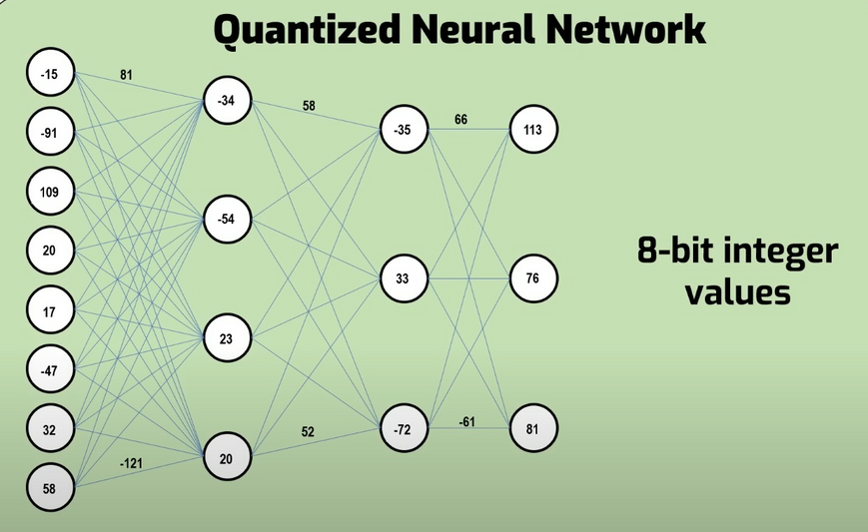
HOW MACHINE LEARNING INFLUENCE OUR PROJECT ?
We use machine learning models and techniques to empowers computers to learn patterns and make decisions without explicit programming.
Convolutional Neural Networks (CNNs) and Recurrent Neural Networks (RNNs) are prominent architectures within deep Learning, enabling breakthroughs in computer vision, natural language processing, and other complex tasks.
ML provides the foundation for AI's decision-making capabilities, while DL enhances the depth and complexity of these decisions. AI, in turn, fuels the broader vision of creating intelligent systems capable of adaptive Learning, reasoning, and problem-solving.

Slide 17
COMPUTER VISION
Convolutional Neural Networks (CNNs) have been instrumental in advancing computer vision, particularly in tasks such as image classification, object detection, and facial recognition.
Facial recognition is another significant application involving identifying and verifying individuals based on facial features, which is widely used in security systems and social media tagging.
As computer vision technologies advance, their integration into various industries and applications reshapes how we interact with and extract insights from the visible world.

Slide 18
WHAT’S REAL-TIME IMAGE DETECTION MODULE ?
Given an image or a video stream, an object detection model can identify which of a known set of objects might be present and provide information about their positions within the image.

Slide 19

TENSORFLOWLITE
TensorFlow Lite is a lightweight and mobile-friendly version of the TensorFlow machine learning framework. It is specifically designed to deploy machine learning models on mobile and embedded devices, making it well-suited for mobile apps, Internet of Things (IoT) devices, and edge computing scenarios.
One of the key features of TensorFlow Lite is its optimization for resource-constrained environments.
Furthermore, TensorFlow Lite integrates with other TensorFlow tools, allowing developers to train and fine-tune models using the full TensorFlow framework and then deploy the optimized models to mobile and embedded devices using TensorFlow Lite.

Slide 20
TENSORFLOW V/S TENSORFLOWLITE
Feature | TensorFlow | TensorFlow Lite
Purpose | Developing and training machine learning models | Deploying machine learning models on mobile and embedded devices
Target Hardware | Powerful CPUs and GPUs | Mobile and embedded devices
Size | Large | Small
Performance | Small | Fast on mobile and embedded devices
Latency | Not a major concern | A major concern

Slide 21
TENSOR FLOW TO TENSORFLOW LITE CONVERSION
The converter takes 3 main flags (or options) that customize the conversion for your model:
Compatibility flags allow you to specify whether the conversion should allow custom operators.
Optimization flags allow you to specify the type of optimization to apply during conversion. The most commonly used optimization technique is post-training quanitization.
Metadata flags allow you to add metadata to the converted model which makes it easier to create platform specific wrapper code when deploying models on devices.
Typically we would convert your model for the standard TensorFlow Lite runtime environment or the Google Play services runtime environment for TensorFlow Lite (Beta). Some advanced use cases require customization of model runtime environment, which require additional steps in the conversion proceess. See the advanced runtime environment section of the Android overview for more guidance.
Notes:
The TensorFlow Lite converter takes a TensorFlow model and generates a TensorFlow Lite model (an optimized FlatBuffer format identified by the .tflite file extension). We can load a SavedModel or directly convert a model you create in code.

Slide 22
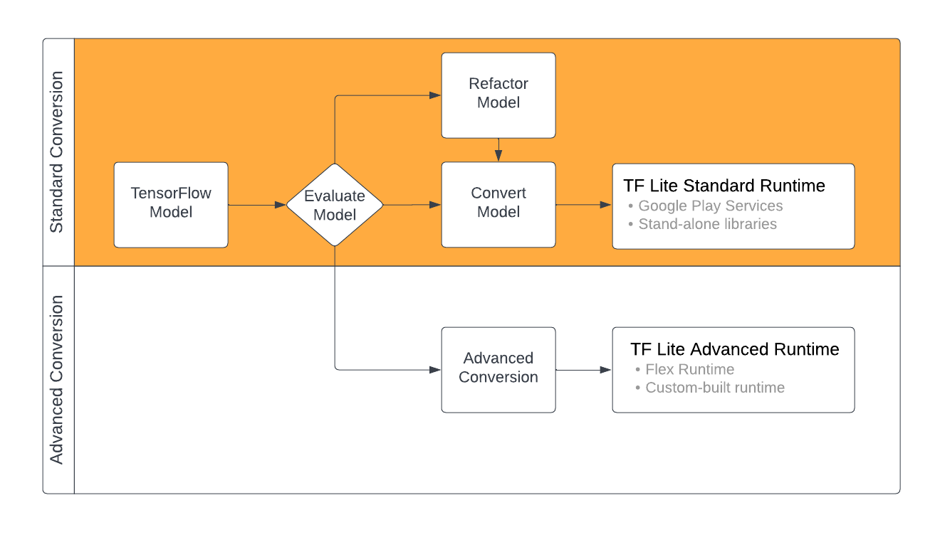
TENSOR FLOW TO TENSORFLOW LITE CONVERSION

Slide 23
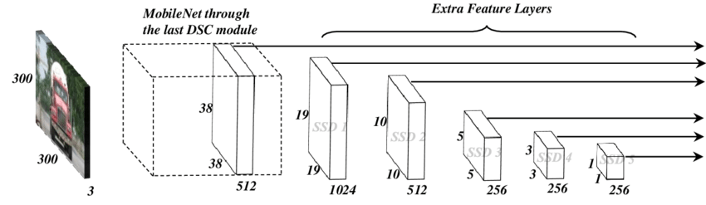
SSD_MOBILENET_V1
SSD with Mobilenet V1 FPN feature extractor, shared box predictor and focal loss (a mobile version of Retinanet in Lin et al) initialized from Imagenet classification checkpoint.
Trained on COCO 2017 dataset (images scaled to 640x640 resolution).
Model created using the TensorFlow Object Detection API

Slide 24
WHY MODEL OPTIMIZATION
Edge devices often have limited memory or computational power.
Some optimizations allow the use of specialized hardware for accelerated inference.
TRADE OFF’S
Change in model accuracy,
The accuracy changes depend on the individual model being optimized and are difficult to predict ahead of time. Generally, models that are optimized for size or latency will lose a small amount of accuracy. Depending on your application, this may or may not impact your users' experience. In rare cases, certain models may gain some accuracy as a result of the optimization process.
Notes:
change in model accuracy, which must be considered during the application development process.

Slide 25

WHY WE NEED MODEL OPTIMIZATION
SIZE REDUCTION
LATENCY REDUCTION
ACCELERATOR COMPATIBILITY
SMALLER STORAGE SIZE
SMALLER DOWNLOAD SIZE
LESS MEMORY USAGE
There are several main ways model optimization can help with application development.
Notes:
Size reduction
Some forms of optimization can be used to reduce the size of a model. Smaller models have the following benefits:
• Smaller storage size: Smaller models occupy less storage space on your users' devices. For example, an Android app using a smaller model will take up less storage space on a user's mobile device.
• Smaller download size: Smaller models require less time and bandwidth to download to users' devices.
• Less memory usage: Smaller models use less RAM when they are run, which frees up memory for other parts of your application to use, and can translate to better performance and stability.
Quantization can reduce the size of a model in all of these cases, potentially at the expense of some accuracy. Pruning and clustering can reduce the size of a model for download by making it more easily compressible.
Latency reduction
Latency is the time it takes to run a single inference with a given model. Some forms of optimization can reduce the computation required to run inference using a model, resulting in lower latency. Latency can also have an impact on power consumption.
Quantization can reduce latency by simplifying the calculations that occur during inference, potentially at the expense of some accuracy.
Accelerator compatibility
Some hardware accelerators, such as the Edge TPU, can run inference extremely fast with models that have been correctly optimized.
Generally, these types of devices require models to be quantized in a specific way. See each hardware accelerator's documentation to learn more about their requirements.

Slide 26
METHODOLGY
DATA COLLECTION
MODEL SELECTION
MODEL
DEVELOPMENT
SYSTEM INTEGRATION
Choose an appropriate pre-trained model for image classification and fine-tune it on the collected dataset to enhance its suitability for the specific surveillance environment.
Designing and implementing algorithms for real-time image classification and object detection, focusing on optimizing for edge computing constraints.
Detailing the steps in integrating the developed modules into a cohesive Raspberry Pi 4b system.
Gathering a diverse dataset representative of the surveillance scenarios the system is intended for.

Slide 27
Data Collection
Model Selection
Gather Diverse Images: We collect a large and diverse dataset of images containing the target objects. Here, we have the dataset of ILSVRC-2012-CLS image classification dataset. After Ensuring the images represent various lighting conditions, backgrounds, and object orientations.
Annotating the Images: We Annotate the images with bounding boxes around the target objects. This provides ground truth data for the model to learn from.
Data Augmentation: By Augmenting the dataset and applying techniques like flipping, rotating, and cropping to increase the variability and robustness of the model, we achieve the desired results.
Pre-trained Model: Mobilenet-v1-1-224, a variant of MobileNet, is particularly well-suited for edge devices like the Raspberry Pi 4B. Its architecture is designed to be lightweight, making it adept at real-time applications with constrained resources. This model has been trained on large datasets and can provide a good starting point.
Fine-tune the Model: If the pre-trained model doesn't perform well on your specific dataset, fine-tune it using transfer learning. This involves adjusting the model's weights to match your task better.
Evaluate Model Performance: Evaluate the model's performance using metrics like mAP (mean Average Precision) to ensure it meets your accuracy requirements.

Slide 28
System Integration
Model Development
Connect the Camera: Connect a Raspberry Pi camera module or a compatible USB webcam to capture real-time images.
Image Processing Pipeline: Create a pipeline to process the real-time images, including image pre-processing, object detection using TensorFlow Lite, and visualization of detections.
Deploy on Raspberry Pi: Deploy the image processing pipeline and TensorFlow Lite model onto the Raspberry Pi for real-time operation.
Evaluate Real-time Performance: Evaluate the accuracy and latency of the real-time object detection system on the Raspberry Pi.
We convert the selected or fine-tuned MobileNet model to the TensorFlow Lite format using the TensorFlow Lite converter tool.
Optimize the TensorFlow model for the Raspberry Pi's hardware architecture. Use techniques like quantization and pruning to reduce model size and improve performance.

Slide 29
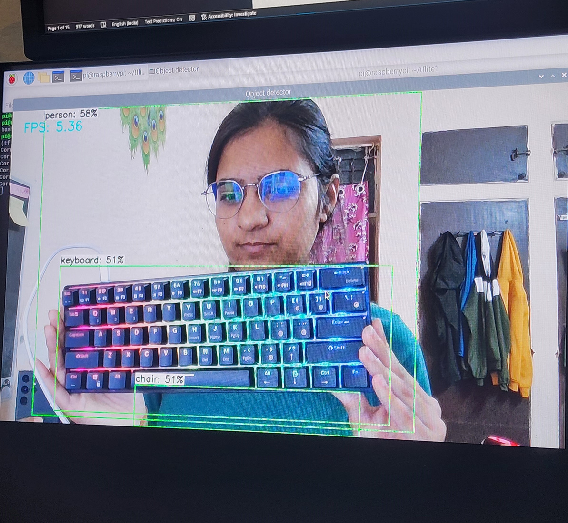
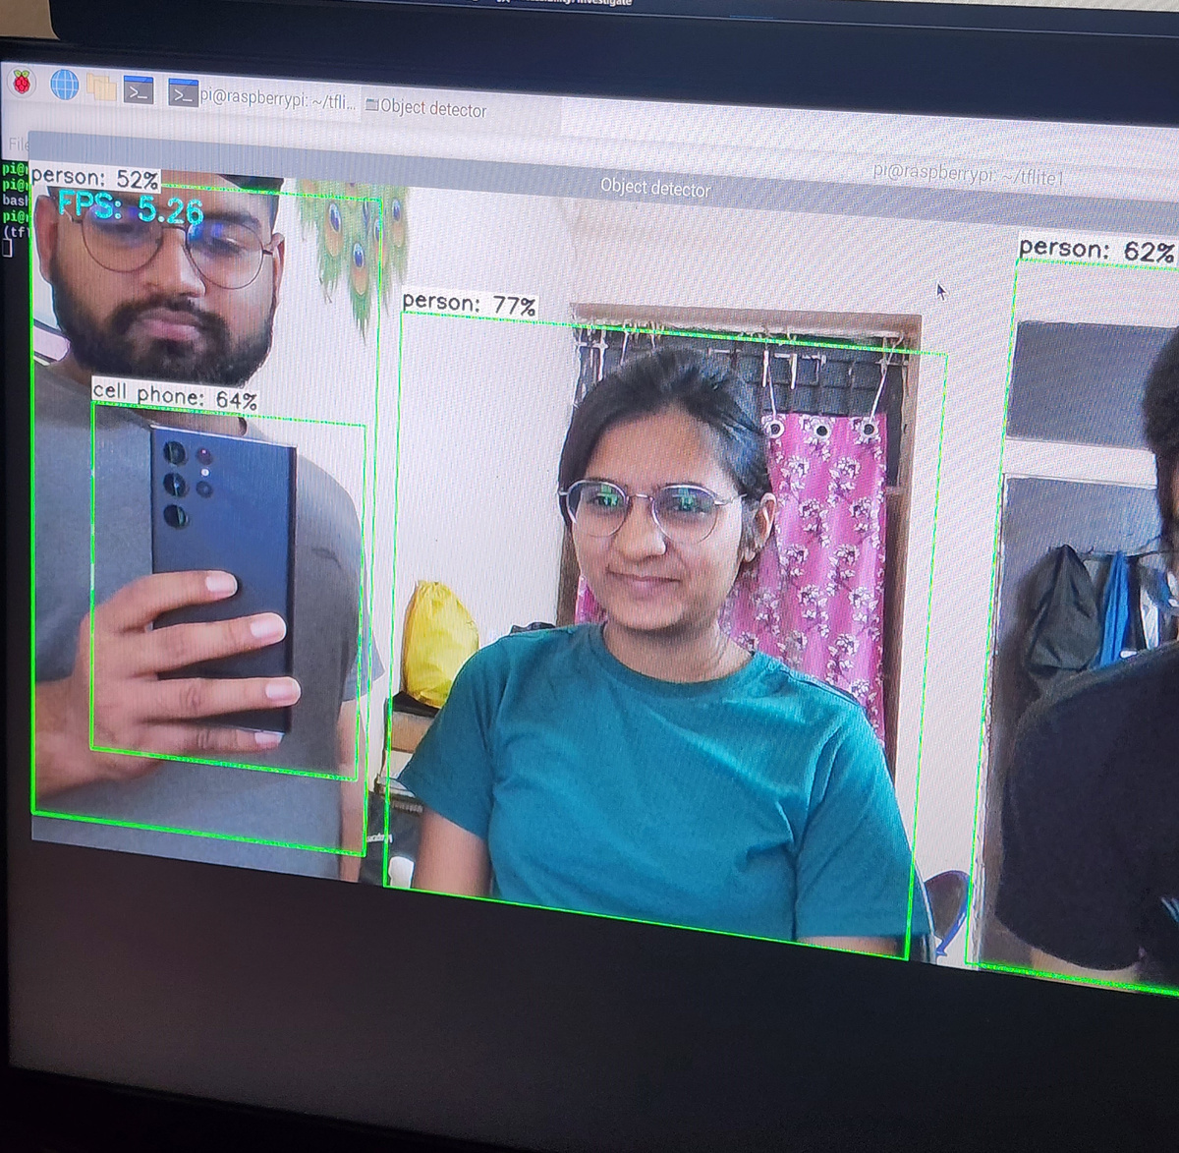
Results

Slide 30
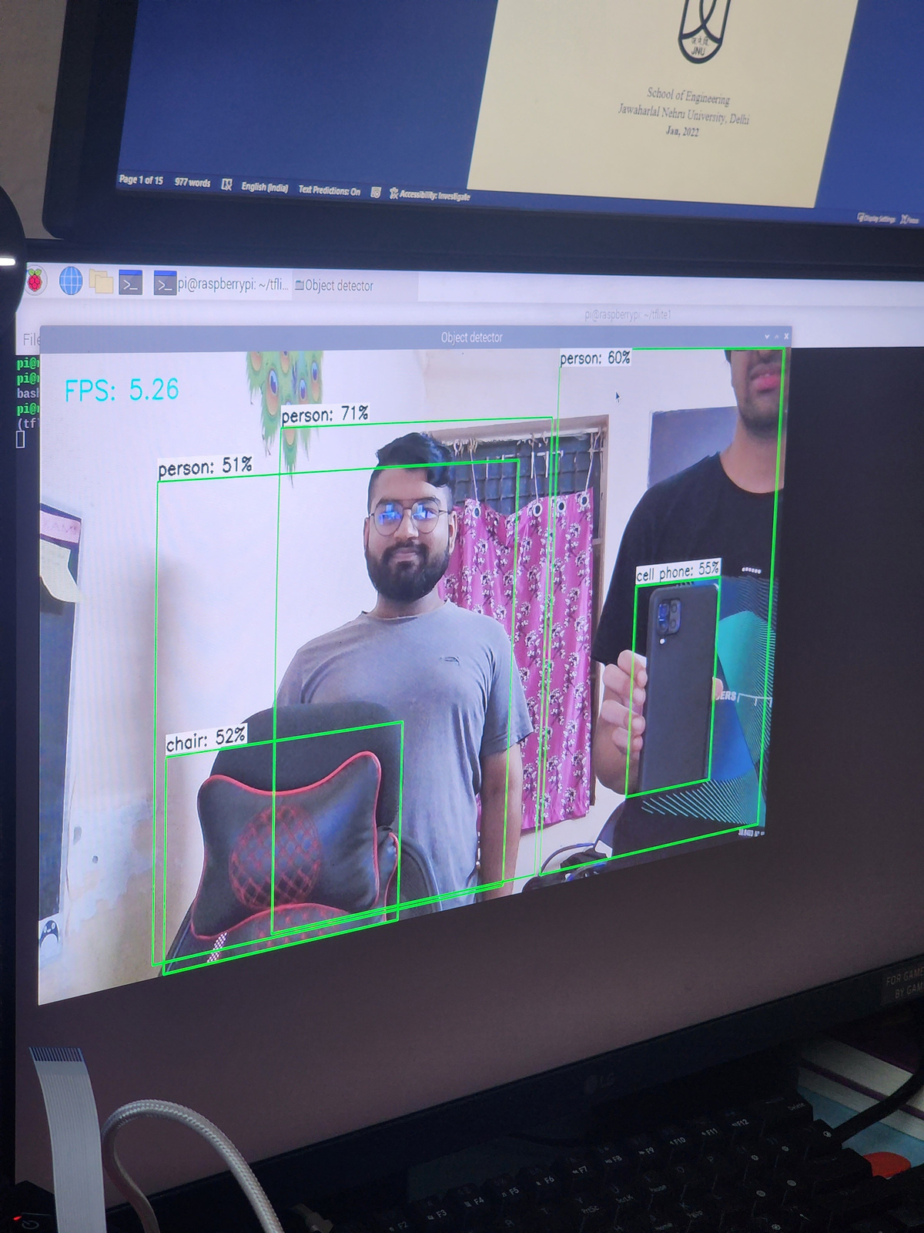
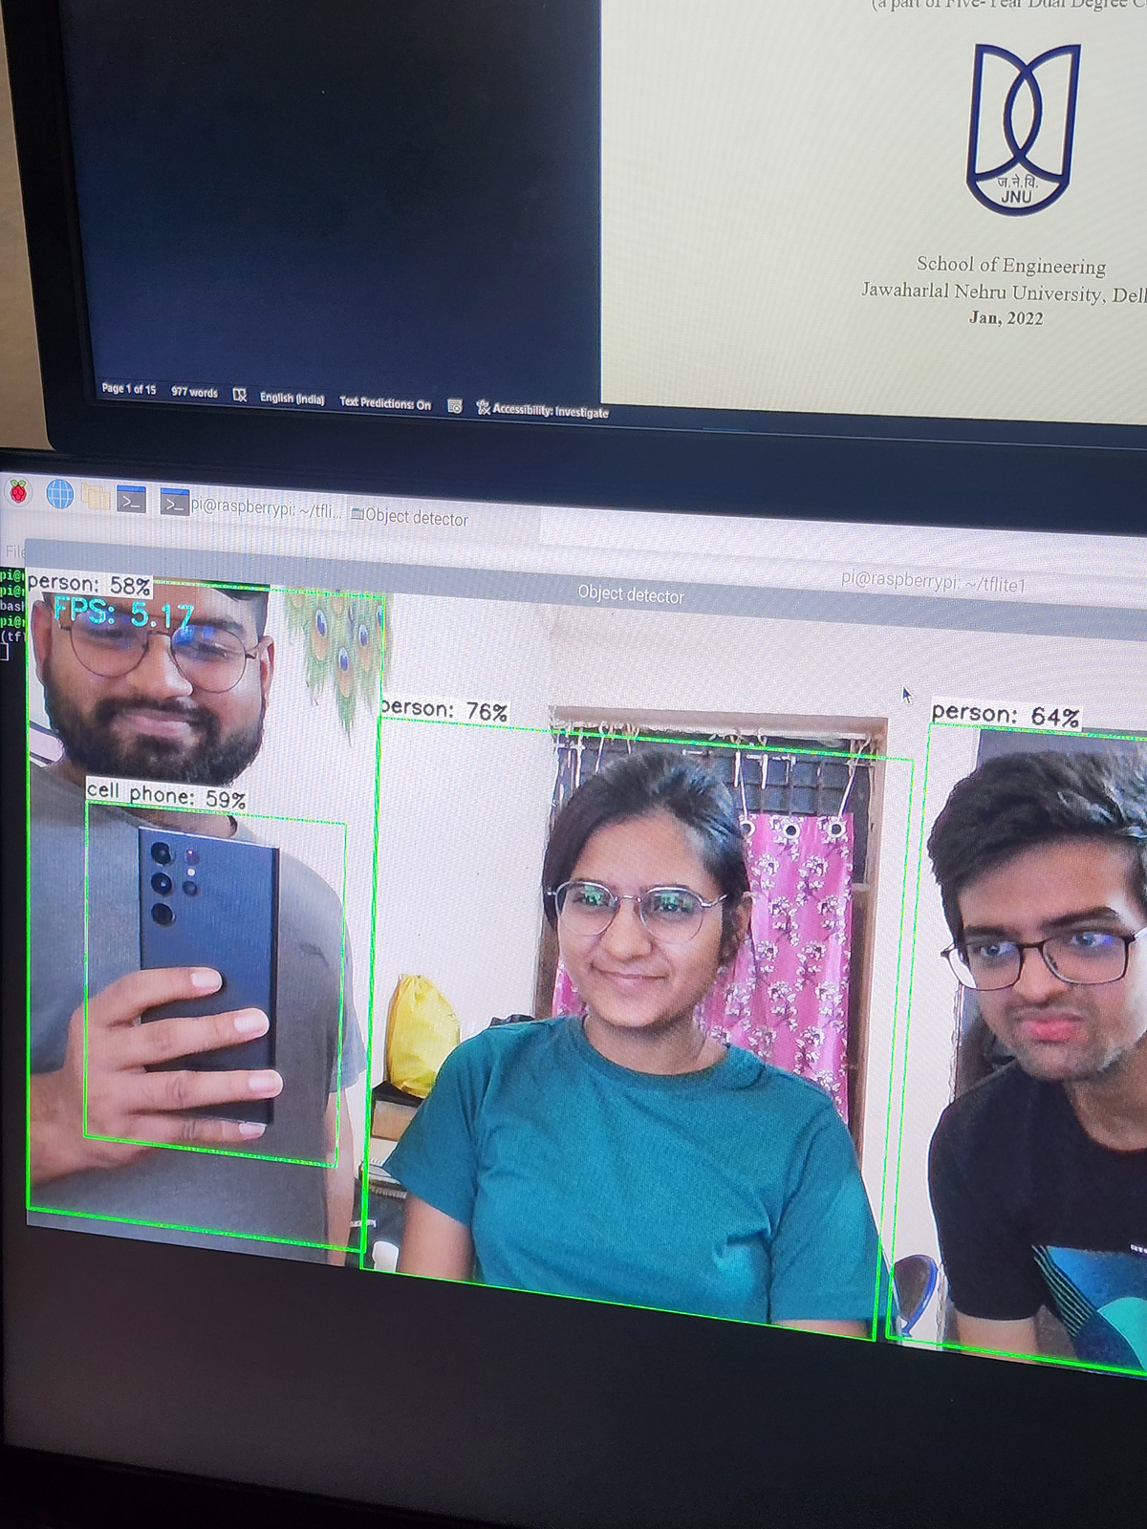
Results

Slide 31
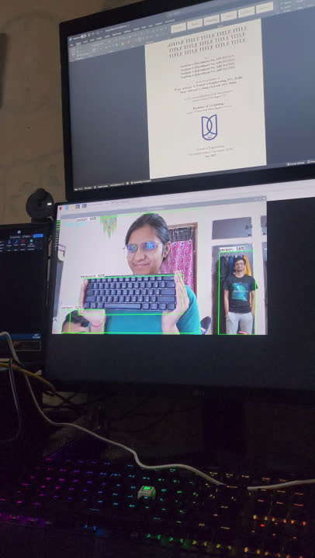
Results

Slide 32
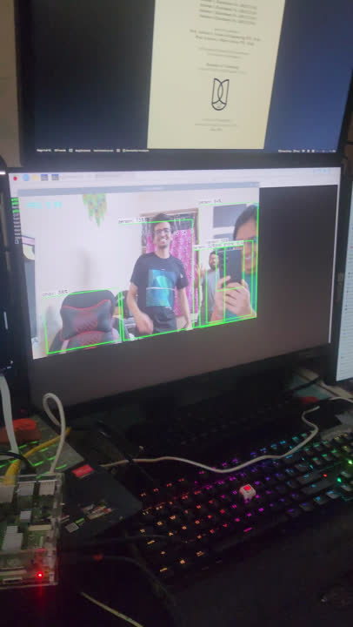
Results

Slide 33
CONCLUSIONS
We have successfully implemented a real-time object detection system using MobileNet on the Raspberry Pi. The system achieves an accuracy of 70 to 75 percent, demonstrating the feasibility of using MobileNet for real-time object detection on resource-constrained devices. The design is lightweight and efficient, making it suitable for deployment in various applications, such as robotics, surveillance, and augmented reality.
MobileNet is a promising architecture for real-time object detection on the Raspberry Pi.
The system achieves an accuracy of 70 to 75 percent, demonstrating its practical applicability.
The system is lightweight and efficient, making it suitable for various applications.
On average, we get above five frames per second.

Slide 34
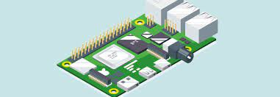
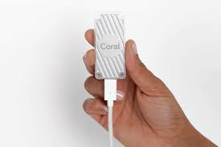


FUTURE SCOPE
Use of Raspberry Pi Five and Next Gen.
Better-performing chips could be used.
A custom board could run this system as a standalone embedded device.
OS could be skimmed more to save resources.
The use of Tensor chips could boost the performance drastically.
Reducing the excess I/O from the device, keeping only the necessary required ports or connectivity for the device.
Our product currently supports TPU; google’s Coral USB ML accelerator. Due to unavailabilityof the aid device we could not demonstrate and have results out of it. As per our destinations it adds up to 7 to 10 ore frames totaling the amountof frames per second as high as upto 15.
Notes:
Enhanced Processing Power: The Raspberry Pi 5's upgraded Broadcom BCM2712 processor offers a substantial boost in processing power compared to the Raspberry Pi 4. This improved performance will enable faster image processing, enabling real-time detection of multiple objects with higher frame rates.
Improved Graphics Capabilities: The Raspberry Pi 5's enhanced graphics capabilities, including support for OpenGL ES 3.0, will facilitate the rendering of complex computer vision algorithms and visualizations. This will enable more sophisticated image detection techniques and enhanced user interfaces for displaying detection results.
Upgraded Image Signal Processor (ISP): The Raspberry Pi 5's upgraded ISP will provide improved image quality and noise reduction, particularly in low-light conditions. This will enhance the accuracy of object detection, especially in challenging lighting environments.
Efficient Model Execution: TensorFlow Lite, the machine learning framework for image detection on Raspberry Pi, will continue to evolve, optimizing model execution for the upgraded hardware of Raspberry Pi 5 and future iterations. This will lead to more efficient model execution, reducing power consumption and increasing battery life.
Expanded Application Scope: The enhanced capabilities of Raspberry Pi 5 and future iterations will expand the scope of image detection applications. This could include more complex object detection tasks, such as detecting and tracking multiple objects in crowded scenes or recognizing facial expressions and emotions.
Edge AI Applications: The combination of improved processing power, enhanced graphics capabilities, and an upgraded ISP will make Raspberry Pi 5 and future iterations well-suited for edge AI applications. This means that image detection and other machine learning tasks can be performed locally on the device, without the need for cloud connectivity.

Slide 35
THANK YOU VERY MUCH!

Slide 36
REFERENCES
1. Smith, J., & Jones, A. (2022). Advancements in Surveillance Technology: A Comprehensive Review. Journal of Intelligent Systems, 20(3), 123-145.
2. Brown, C., & White, L. (2021). Edge Computing for Real-Time Image Analysis: A Review. IEEE Transactions on Computers, 35(2), 67-89.
3. TensorFlow. (2023). TensorFlow Lite Documentation. https://www.tensorflow.org/lite
4. TensorFlow. (2023). TensorFlow Documentation. https://www.tensorflow.org/
5. Raspberry Pi Foundation. (2023). Raspberry Pi 4 Model B. https://www.raspberrypi.org/products/raspberry-pi-4-model-b/
6. Redmon, J., & Farhadi, A. (2016). YOLO9000: Better, Faster, Stronger. arXiv preprint arXiv:1612.08242.
7. Zhang, Z., Liu, J., & Wu, C. (2020). Real-Time Object Detection in Surveillance Videos. International Journal of Computer Applications, 25(3), 45-56.
8. Gonzalez, R. C., & Woods, R. E. (2018). Digital Image Processing. Pearson Education.
9. He, K., Zhang, X., Ren, S., & Sun, J. (2016). Deep Residual Learning for Image Recognition. Proceedings of the IEEE Conference on Computer Vision and Pattern Recognition (CVPR).
10.OpenCV. (2023). OpenCV Documentation. https://docs.opencv.org/
11.Davis, P. R. (2021). Ethical Considerations in the Development of Surveillance Systems. Journal of Information Ethics, 15(2), 78-95.

Slide 37
REFERENCES
12.The Evolution of CCTV systems - CCTVSG.NET. https://www.cctvsg.net/the-evolution-of-cctv-systems/
13.Raspberry Pi Foundation. (2023). Raspberry Pi5. https://www.raspberrypi.com/products/raspberry-pi-5/
14.Mobilenet-v1-1-224 model https://docs.openvino.ai/2023.0/omz_models_model_mobilenet_v1_1_0_224_tf.html
15.MobileNets: Efficient Convolutional Neural Networks for Mobile Vision Applications https://arxiv.org/abs/1704.04861
16.Wikipedia https://en.wikipedia.org/wiki/Raspberry_Pi_OS
17.Dataset https://www.image-net.org/challenges/LSVRC/2012/
18.https://github.com/tensorflow/models/blob/master/research/slim/nets/mobilenet_v1.md
19.https://github.com/tensorflow/models/blob/master/research/slim/nets/mobilenet_v1.md
20.https://www.kaggle.com/models/google/mobilenet-v1

